Slide 1





E-Commerce Sales Analysis
Name: T.MEENAKSHI SUNDAR Guide: P.Raja,Master Trainer
NM-ID:aut923821114302
E-Mail ID:tmeenakshisundar552@gmail.com
Disclaimer: The content is curated for educational purposes only.
Notes:
Slides: Prepare a short slide deck (10-12 slides) summarizing the project objectives, methodology, and key results.

Slide 2
OUTLINE
Abstract of the Project
Problem Statement
Proposed Solution
System Architecture
Live Demo of the Project
Embedded Video of Project
Conclusion
Future Scope

Slide 3
Abstract
Traffic congestion is a pressing issue in urban areas worldwide, leading to increased fuel consumption, air pollution, and commuting time. Traditional traffic management systems often rely on static signals and limited real-time data, which cannot effectively adapt to unpredictable traffic conditions. This paper proposes an AI-based Traffic Management System (AI-TMS) that leverages machine learning algorithms, computer vision, and real-time data from IoT-enabled devices to dynamically control and optimize traffic flow.

Slide 4
Problem Statement
With rapid urbanization and a growing number of vehicles, traffic congestion has become a critical issue in cities worldwide. Current traffic management systems often rely on fixed-timing signals and limited real-time data, which are ineffective in handling unpredictable traffic conditions. This leads to frequent traffic jams, increased travel times, high fuel consumption, and elevated air pollution levels. Traditional systems lack the ability to dynamically adapt to changing traffic patterns or respond to emergencies, creating inefficiencies that impact economic productivity and quality of life

Slide 5
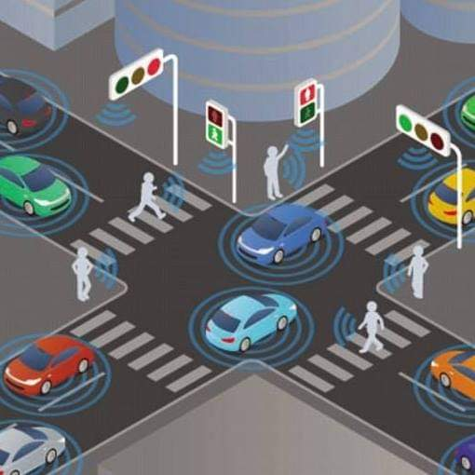
Proposed Solution
The methodology for a traffic management system generally involves several steps to ensure efficient, safe, and responsive management of traffic flow. Below is a breakdown of a commonly proposed methodology

Slide 6
System Architecture
An AI-based traffic management system architecture typically consists of multiple components working together to monitor, analyze, and optimize traffic flow. Here's a high-level architecture outline
Data collection layer
Data preprocessing Layer
AML module Layer
Decision-Making and Control Layer
Communication Layer
Monitoring and Analytics Layer
Feedback and Learning Layer

Slide 7
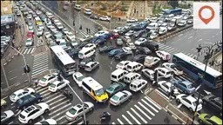
Live Demo Of Project

Slide 8
Video of Project Demo

Slide 9
Conclusion
AI-based traffic management systems represent a transformative approach to addressing modern traffic challenges. By leveraging real-time data collection, advanced AI/ML algorithms, and IoT-enabled infrastructure, these systems optimize traffic flow, reduce congestion, and enhance road safety.
The integration of predictive analytics and dynamic decision-making ensures proactive responses to incidents, while continuous learning mechanisms enable system adaptability to evolving urban needs. Such systems not only improve commuter experiences but also contribute to sustainability by minimizing fuel consumption and reducing carbon emissions.

Slide 10
Future Scope
The future of AI-based traffic management systems is promising, driven by advancements in technology, urbanization, and the push for sustainability. Below are key areas of future developmen
Integration with Autonomous Vehicles
Advanced Predictive Analytics
Smart City Ecosystem Integration
Sustainable Urban Mobility
Improved Emergency Response Systems

Slide 11
Thank you!
Notes:
thank you very much for joining this PPT, keep learning.

